Slide 1
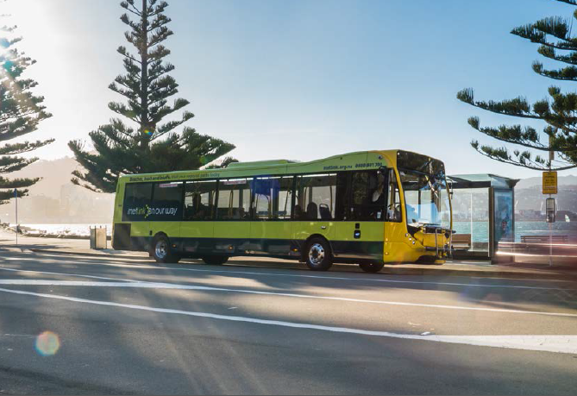
Public Transport Fares
Confidential

Slide 2
Need for the review
To inform the Annual Plan budgeting process.
Purpose is to check:
Fares are within targets (looking back)
Extent of any fare adjustments (looking forward)
Decision made in June with Annual Plan.
Fare changes apply on 1 November.
Confidential
Notes:
Paul K

Slide 3
Assumptions
Long Term Plan:
  Users pay 35-50% of PT operating costs
  Fares increase annually with inflation
Public Transport Plan recommends small incremental changes over larger one-off changes
Better Metlink Fares – 3% increase in 2018, no increase 2019, 1% increase 2020/21
Confidential
Notes:
Paul K

Slide 4
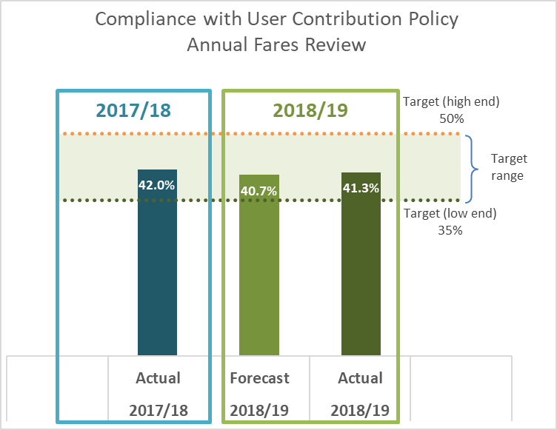
Looking back – within target
Confidential
Notes:
Paul K

Slide 5
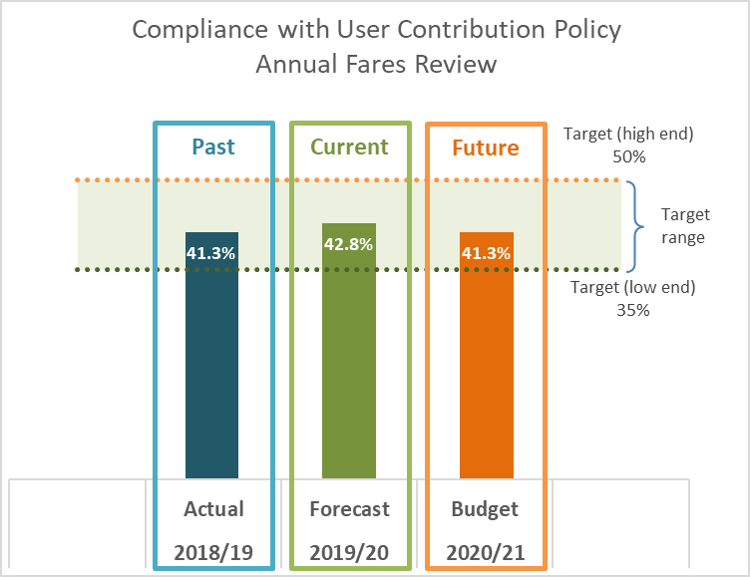
Looking forward – within target
Confidential
Notes:
Paul K

Slide 6
Impacts - increasing fares
% increase | Patronage impact | Revenue impact
1% | - 100k (- 0.3%) | + $570k (+ 0.6%)
2% | - 175k (- 0.5%) | +1.2m (+1.3%)
3% | - 261k (- 0.7%) | +1.9m (+2.0%)
5% | - 454k (- 1.2%) | +3.2m (+3.4%)
Confidential
Notes:
Paul k

Slide 7
Summary
Fares are compliant within targets
LTP budget assumes increases with inflation, (currently at 1.7%)
Better Metlink Fares package assumed 1% increase
Decision to increase fares needs to consider current context, performance and public interest
Paper to Council in March will provide more input and recommendations
Confidential
Notes:
Paul K

Slide 8
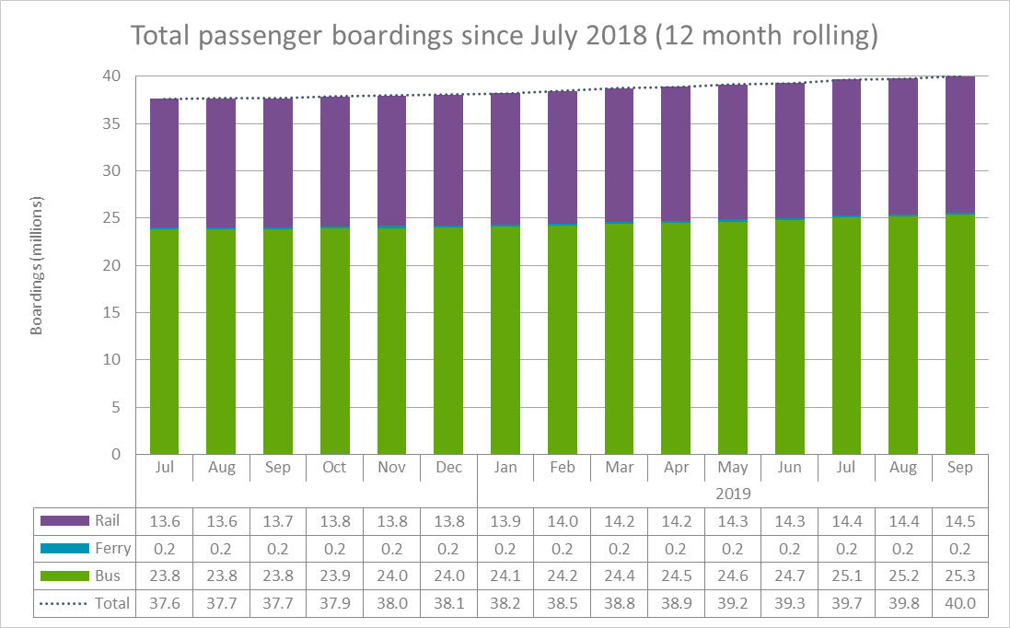
Patronage growth 2018/19
Confidential

Slide 9
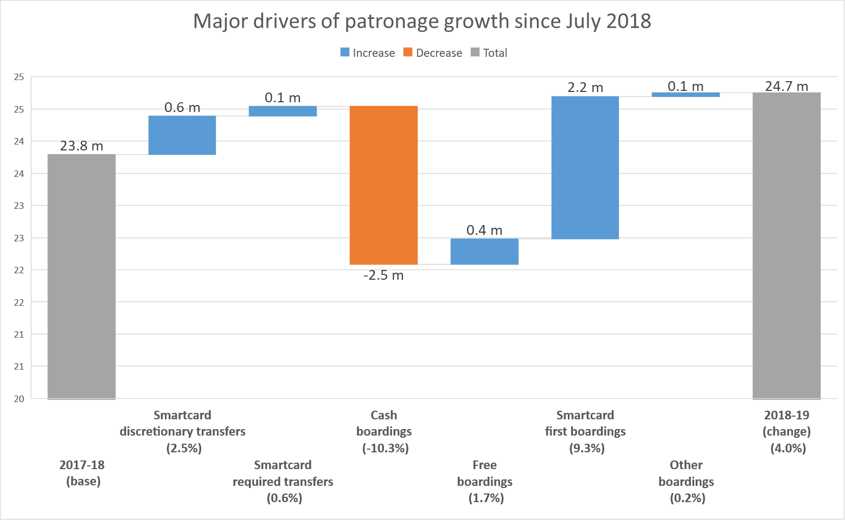
Drivers of pax growth - bus
Confidential
Notes:
Paul K

Slide 10
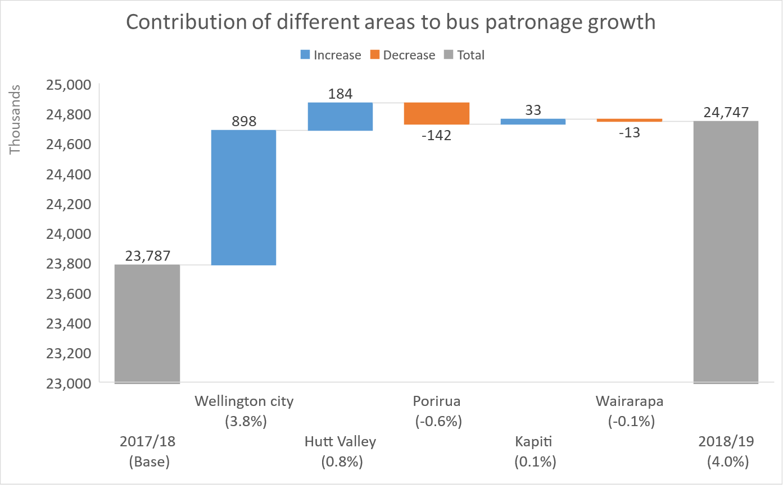
Bus patronage by area
Confidential
Notes:
Paul K

Slide 11
Looking back - mode
Users share of direct operating costs by mode
Confidential
Mode | Share
Rail | 58.1%
Bus | 53.7%
Ferry | 78.6%
Total | 56.2%
Notes:
Paul K
Actual figures for revenue and operating costs
Close to expected
Key factors – patronage as expected, fare revenue higher for rail (b

