Slide 1
Te Kopuru
Further Explanations

Slide 2
Recap

Slide 3
Transition Rates Remission Policy
  Last year we introduced a new rates remission for the stormwater/wastewater increase
  It is applied to those properties that have an increase of more than $100 and more than 20% of the previous years rates
  It is to be applied for two years 2013/14 and 2014/15
It was automatically applied to all Te Kopuru ratepayers who are charged both wastewater and stormwater
It appeared like this on your rates notice

Slide 4
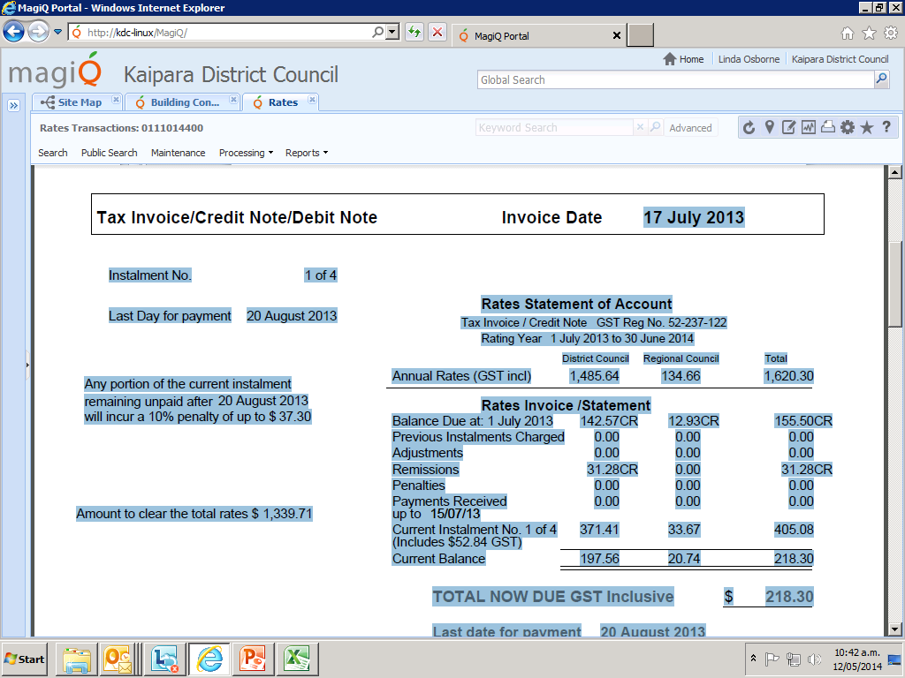
This property received a remission of $31.28 every instalment, total $125.12

Slide 5
The future
  In 2015/16 the remissions will be phased out
  For some this may be difficult to afford
  We are looking at other options and policies to help Te Kopuru ratepayers

Slide 6
  Te Kopuru/Dargaville
  Rates have been relatively low
Year | Indicative Annual Rates Te Kopuru ($50,000 Land Value) | Indicative Annual Rates Dargaville ($50,000 Land Value)
2009/10 | $1,031 | $1,096
2010/11 | $1,077 | $1,156
2011/12 | $1,138 | $1,223
2012/13 | $1,341 | $1,661
2013/14 | $1,526 | $1,915
2014/15 (proposed) | $1,649 | $2,002

Slide 7
Costs

Slide 8
Te Kopuru Wastewater Costs
 | 2012/2013 see separate breakdown | 2011/2012 see separate breakdown | 2010/2011 see separate breakdown | 2009/2010 see separate breakdown | 2008/2009 see separate breakdown
Total Income from rates | 64,031 | 79,748 | 76,528 | 73,469 | 69,982
Total Operating Expenditure | 227,852 | 91,813 | 76,835 | 73,153 | 116,848
Activity Operating surplus/(deficit) | (163,821) | (12,065) | (307) | (316) | (46,867)

Slide 9
Large Wastewater Historical Costs
1981 Sewerage Scheme constructed. Estimate for initial system $243,700
2000 Wetland (around oxidation pond) Total cost $61,843.40 – see attached information
2007/08 Renewal of the Aerial line to the oxidation pond. Estimated around $100,000 – see attached information for $63,000 of these costs
2009/10 Raising and repairs to the oxidation pond waveband $19, 946.40 – see attached information
2012/13 Desludging of oxidation pond $147, 417.08 – see attached information

Slide 10
Wastewater Future Monitoring Costs
Council’s consent with Northland Regional Council requires us to monitor results
The Te Kopuru Scheme does not have a discharge measuring device
We investigated this in 2012 but no funds were available
A discharge measuring device needs to be installed
Environmental standards are likely to get tougher

Slide 11
Wastewater Costs- Operating
Repairs and maintenance – District wide average
Management and Administration – District wide average
Depreciation – Local
Loan repayment – Local
These costs are funded from rates
Depreciation charged to rates in Te Kopuru totals $38,146 annually

Slide 12
Wastewater Costs - Capital
Renewal of existing assets
- these costs are funded from depreciation charged
New assets
- these costs are funded from either:
- depreciation charged or
- loans that are then repaid over time

Slide 13
De-sludging the Ponds
De-sludging is an operational cost and should be funded by rates
Te Kopuru couldn’t afford to pay this way
De-sludging would benefit ratepayers for a number of years
Loan was raised in 2013/14 with repayment to be spread over 10 years

Slide 14
Wastewater Costs - Capital
Te Kopuru’s Waste Water Assets
Asset | Net Book Value $ | Depreciation $
Lines | 238,068 | 24,000 pa
Points | 143,821 | 3,000 pa
Treatment Pond | 601,723 | 11,000 pa
Total | 983,612
NB: Different components have different estimated lifespans and these estimations may change when we revalue them every three years

Slide 15
Te Kopuru’s Depreciation
In the 2012/2022 Long Term Plan we consulted on and made a decision to defer fully funding depreciation, in years in which there are no renewals needed, for the first four years.
This means we only charged depreciation in a year if there was a need for a renewal. If the cost of the renewal was higher, we borrowed to fund it.

Slide 16
Processes

Slide 17
Tender Process for De-sludging
Expressions of interest were invited to contractors who had undertaken previous de-sludging
Three contractors confirmed they were interested (Hydracare, Aquacare & Northland Waste)
Two of the three contractors attended a site meeting
Only one tender was received (Hydracare)
This was within Council’s engineers estimate
Council’s Procurement Policy – see attached

Slide 18
Consultation
Covered by Section 82 of LGA 2002
Reasonable access to relevant information
Encouraged to present views
Clear information about the purpose of consultation and scope of decisions to be made
Reasonable opportunity to present those views to the local authority
Received by local authority with an open mind
Given feedback on the relevant decisions made and the reasons for them

Slide 19
KDC Consultation on Draft Annual Plan
Council holds pre draft consultation meetings during the year
DAP is drafted by staff - Must fit with the Long Term Plan
Approved by Auditors
Adopted for Consultation (25 February meeting)
DAP and Summary circulated and made available (media, libraries, offices, website)
Consultation for a month
Public meetings around District
Specifically affected community meetings (eg Te Kopuru)
Submissions made (email, fax, phone, letter, form, online)
Hearings held (Dargaville, Mangawhai, Maungaturoto)
Issues and Options papers prepared for consideration
Deliberation meeting of Council to consider the issues and options
Amendments made – checked again by auditors
Annual Plan adopted – June Council meeting
Feedback letters to all submitters

Slide 20
Government Valuations
Undertaken by Quotable Value, every three years
Use the current market value
Due out around early December 2014
Have until late January to object
QV may visit a property if they believe the assessed value may be incorrect

Slide 21
Rates Rebate Scheme
Available for low income ratepayers
We will send a form out to all those that have received a rates rebate
We will advertise when the new application forms are available, on our website and Dargaville and Districts News
- For 2013/14 to date, 49 ratepayers in Te Kopuru have had a rates rebate, totaling $28,700
The average for Te Kopuru is $585

Slide 22
Help Desk
We may not have always got it right
We have a new Customer Services Manager
We have a new Improvement Plan that is being implemented now
Ring 0800 727 059 and talk to a customer services officer
Your request should be answered within 2 weeks
If its not let us know
We are dedicated to improving customer service and we want to get it right!

Slide 23
The big picture…
Everybody in the District contributes to the big picture
Rates pay for our libraries, parks and reserves, public toilets, roads and footpaths
We all need to use roads to go to the shops, schools or work
The financial situation remains challenging and we need to rate accordingly

