Slide 1
Edgeware Village Drainage and Kerb Replacement Option
Kevin McDonnell – Team Leader Asset Planning Stormwater and Waterways
Tom Parsons – Surface Water Engineer

Slide 2
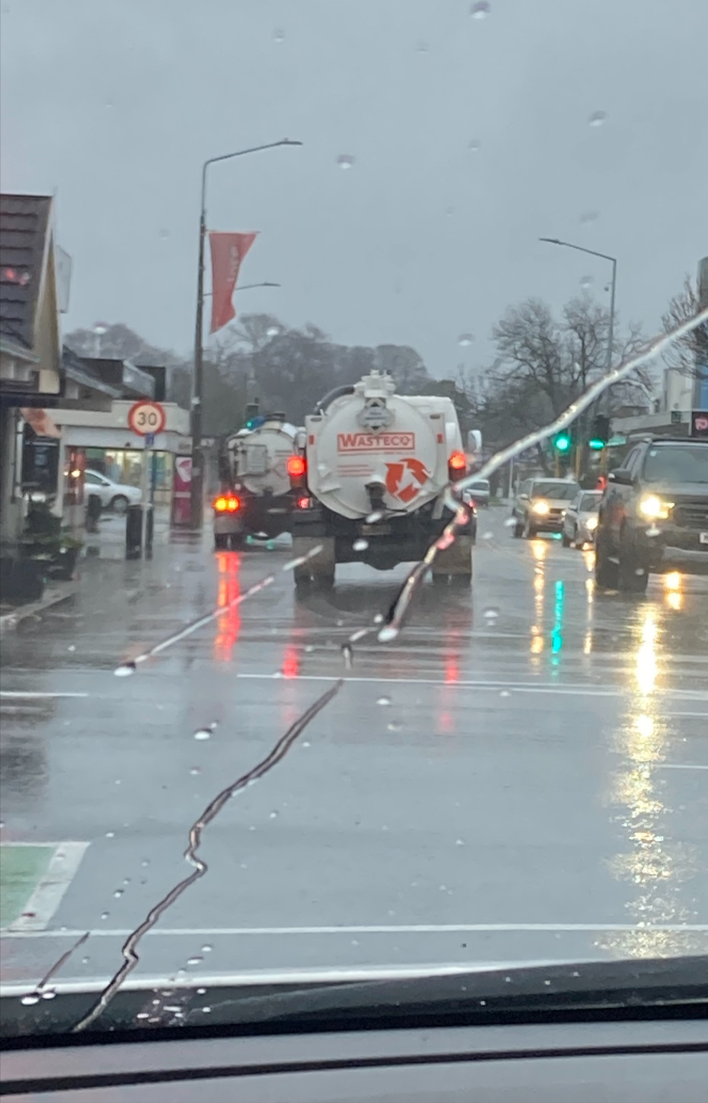
Agenda
Quick recap
Whiteboard session on drainage challenge
Drainage assessment
Kerb replacement concept
Other issues raised
Council report
Board feedback

Slide 3
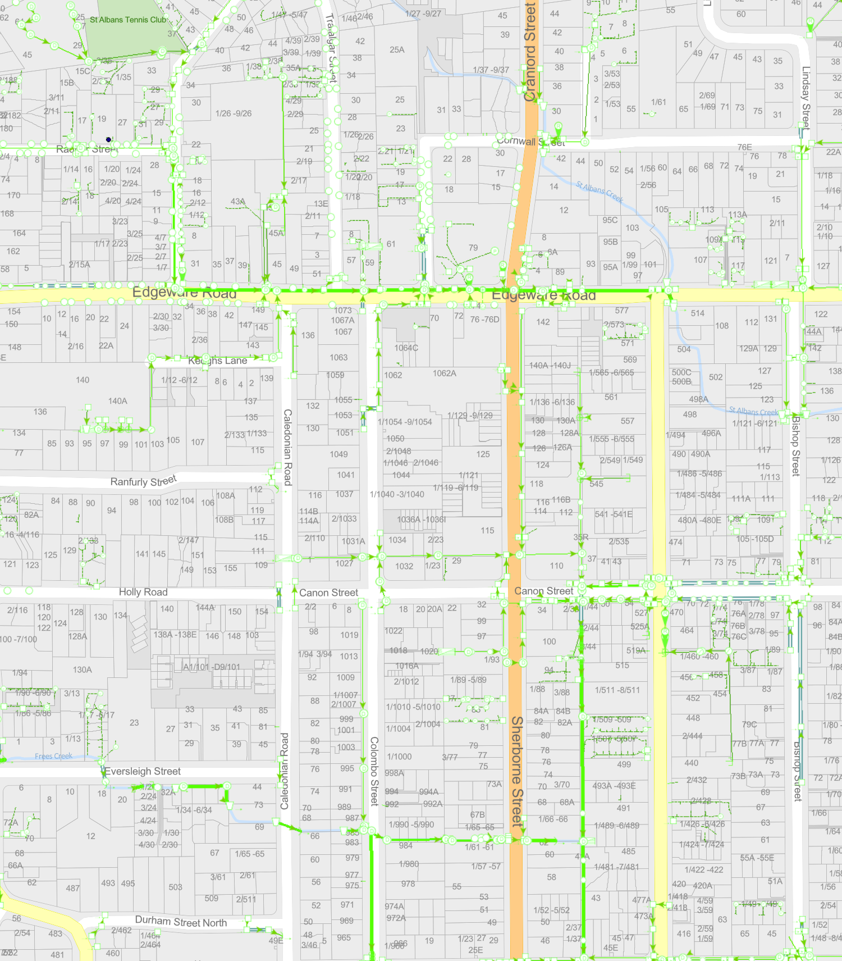
Local Situation - Recap
Low lying area
Frequent flood complaints
Below creek flood level
Can’t drain by gravity if creek in flood
Long way to Ōtākaro / Avon
INSERT TOPO MAP

Slide 4
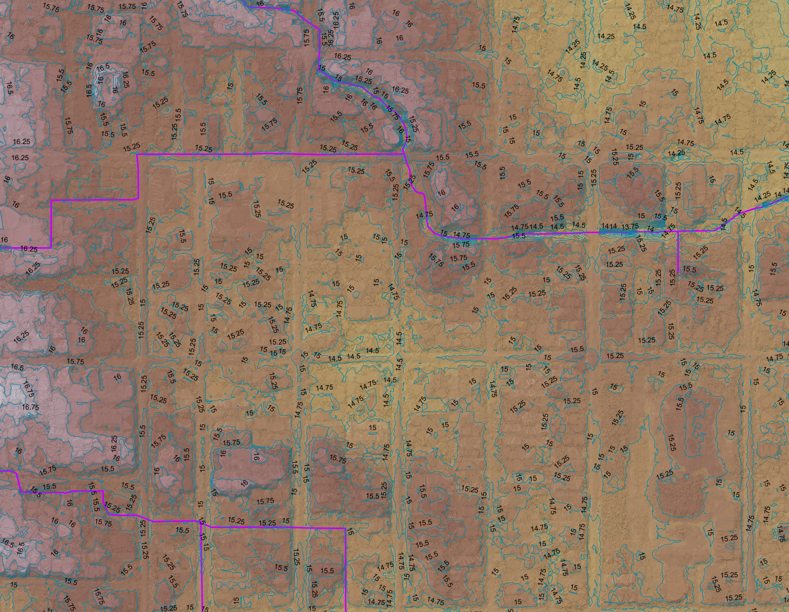
Local Situation Recap
Creek runs along ridge
Creek banks higher than village so stormwater ponds locally when creek in flood
Recent flooding of road

Slide 5
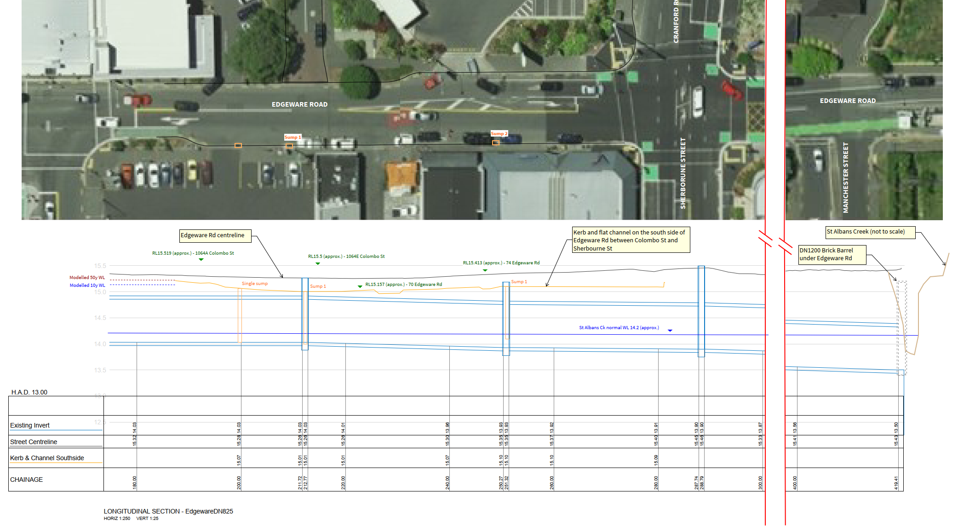
Whiteboard Session
C
D
E
B
A
C
D
E
B
A

Slide 6
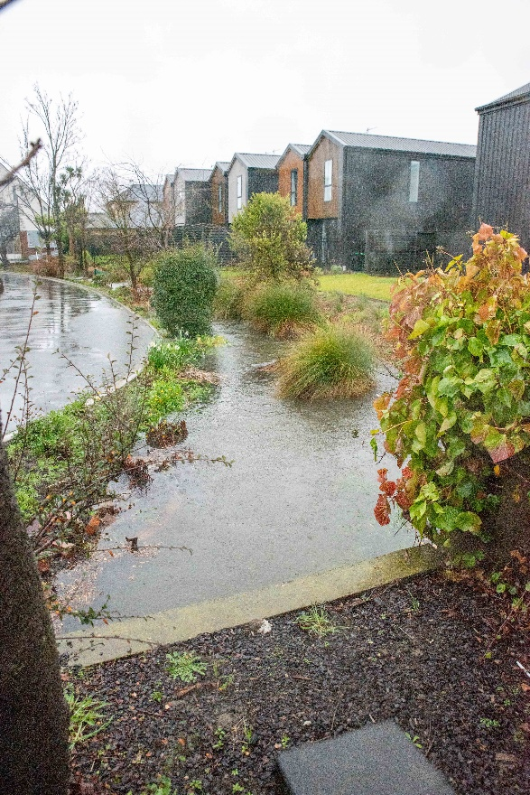
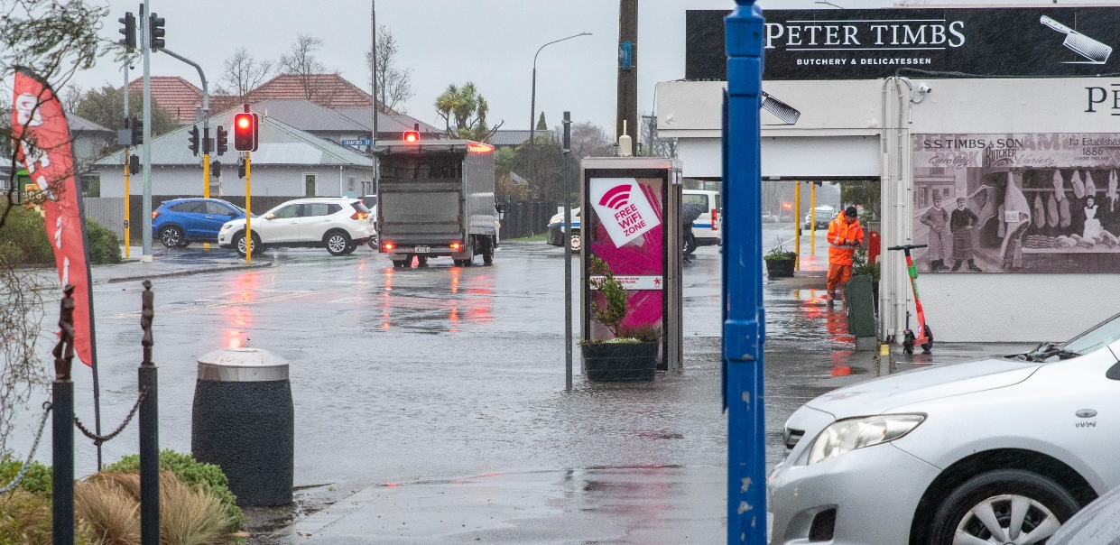
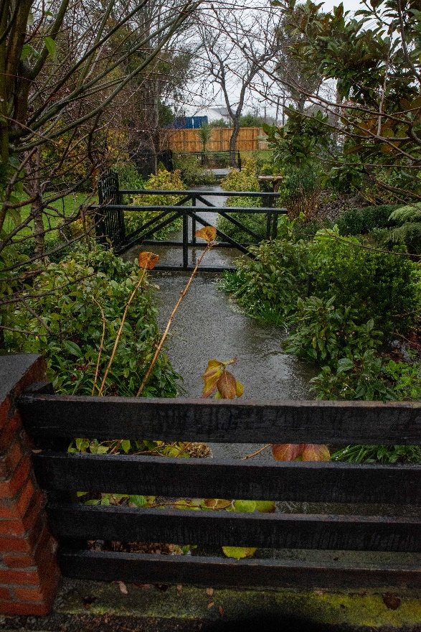
Whiteboard Session
E
D
A
D
E
C
C
A
E
B
B
C
D
E
B
A
E

Slide 7
Drainage Assessment
Kerb is not a standard shape
Stormwater network has capacity
  Pipe in street big enough
  Enough sumps to get water in even with shallow kerb
Creek the issue
“Overall, the local stormwater network has sufficient capacity to meet the 5y design storm requirements for the local catchment with a clear outfall to St Albans Creek.
The main cause of surface flooding issues around Edgeware Village is the combination of high tailwater levels in St Albans Creek and the comparatively low lying area between Colombo Street and Sherbourne Street, which renders gravity drainage ineffective in a significant storm event.
Upgrades to the local kerb and channel, sumps and pipe network will not address this issue.
A wider flood alleviation scheme or changes to floor levels would be required to materially reduce flood risk in the area.”

Slide 8
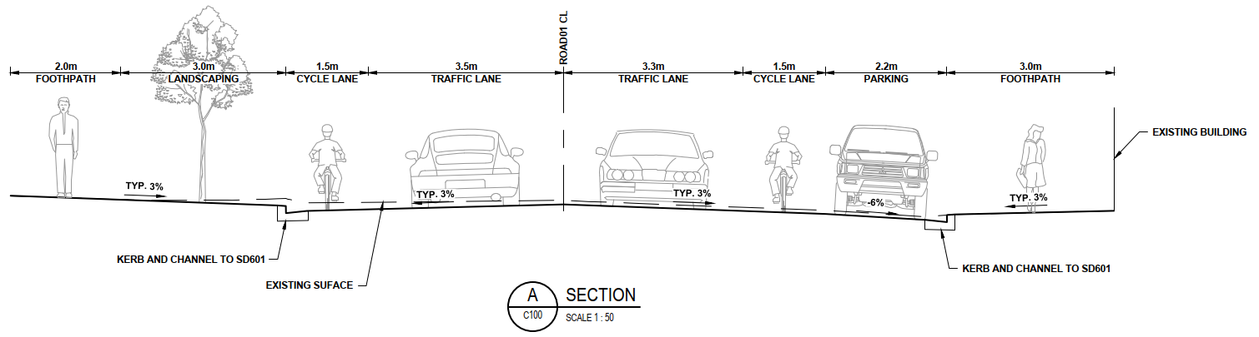
Kerb Replacement Concept
Can’t raise footpath
Flat footpath risky for pedestrians when frosty as can’t drain
Need to lower road and rebuild footpath to get kerb height
Approx. $1.2M and may not align with masterplan

Slide 9
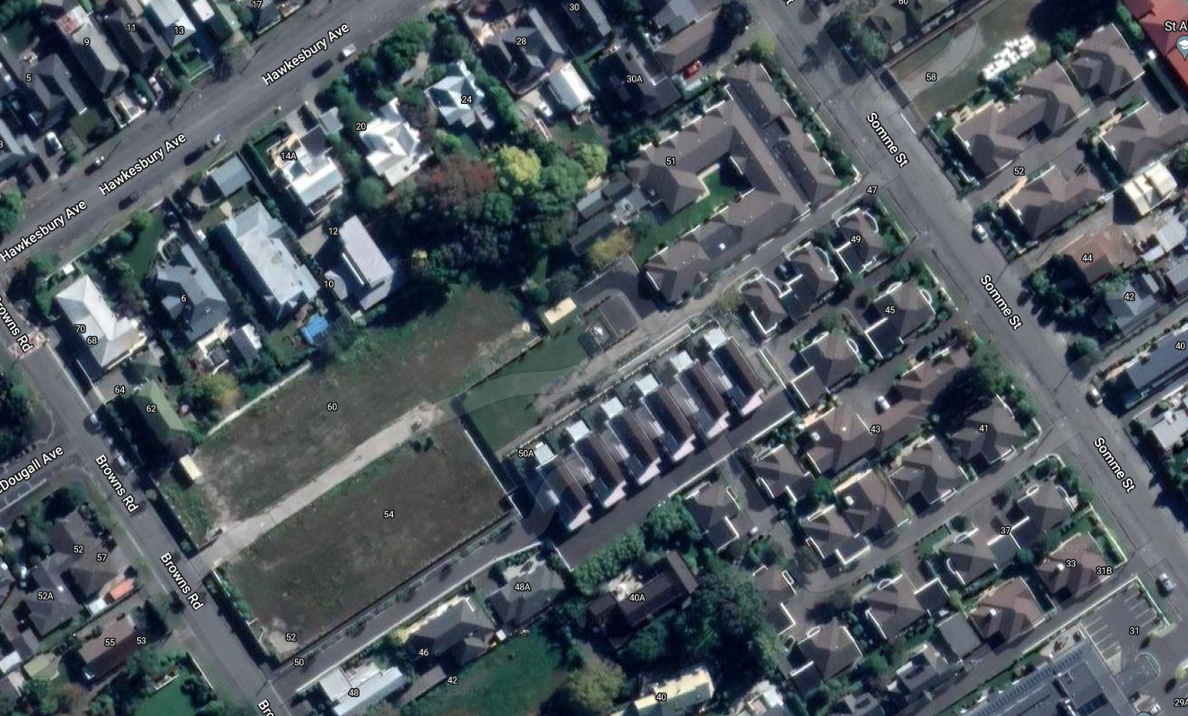
Other Issues
Impact of BP:
  Consent granted by ECan for SW discharge
  Condition 4: The sites stormwater system shall be designed to ensure that site stormwater as overland flow from up to and including a 24 hour duration 2% AEP rainfall event does not leave the site except for secondary flows to the road reserve.
Retirement Village:
  Now demolished with replacement units compliant with district plan floor levels
  Uncertain of future development

Slide 10
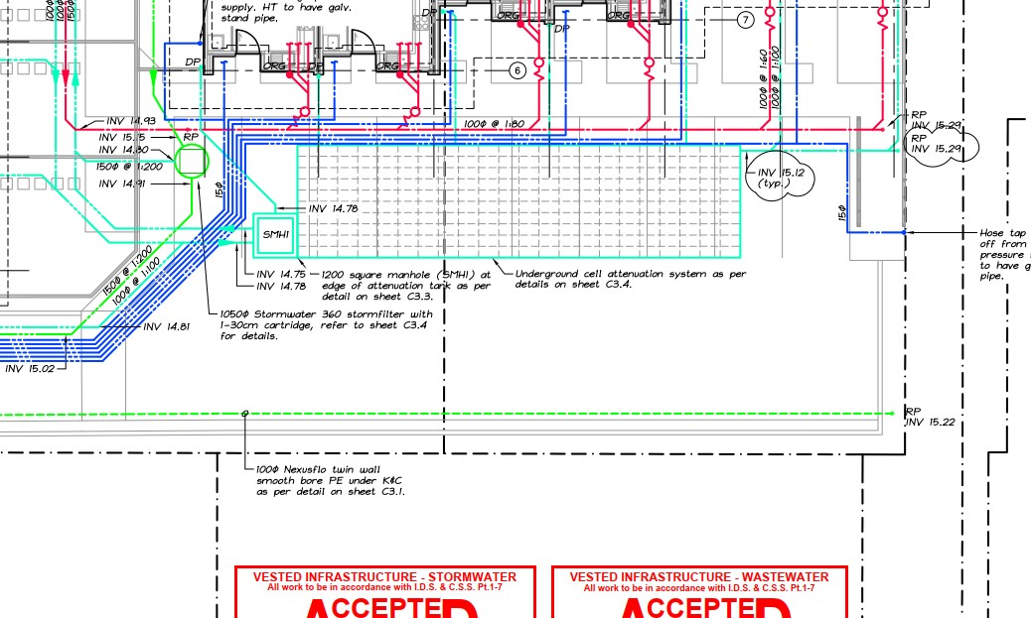
Other Issues
Other development:
  Onsite attenuation (rain tank) if
    150m2 or more of new impervious
    AND exceeding 70% impervious site
    coverage
Other areas at risk:
  Heathcote riverside properties
  Lower Heathcote Valley
  Hoon Hay
  Bishopdale
  Remuera Ave
  Redcliffs
  Sumner
  Brenchley Ave…
107 Edgeware Road – 10 townhouses + associated car parking. Council required this development install a stormwater storage system with at least 25 cubic metres of storage

Slide 11
Other Issues
Recent questions:
  Where does the stormwater grate near the South West corner of Sherbourne / Edgeware Rd flow to?
    Towards Peter Timm’s then back to St Albans Creek
  Are we seeing increased levels of road flooding that could threaten other businesses in the near future? Eg: the car park outside Crisp and the Crisp store itself , the liquor store.
    Flood mapping shows these properties at risk in a 50 yr flood
  Are these businesses receiving individual heavy rain warnings from CCC staff?
    Warnings given through general comms (e.g. newsline)
  What mitigation (while a solution is worked through) is available?
    Potential for individual property owners to protect themselves

Slide 12
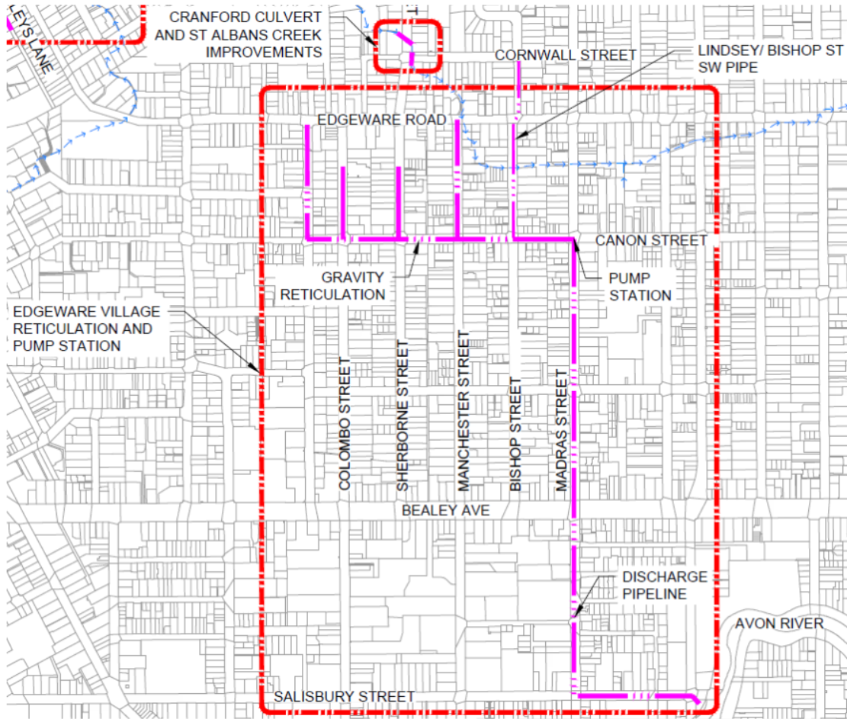
Edgeware Options
Village
  New 2.4m³/s PS
  New network
  ~$23M (whole of life)*
    $15M construction, design, consenting, PM, supervision
    $2M Provisional items
    + Contingency
    + Operational costs
Browns Road (optional extra)
  Culvert upgrade
  New network
  ~$2M*
  *2018 cost estimates

Slide 13
Council Report
Purpose: to seek a decision on Edgeware Village Flood Management
Recommendation: TBC
Option | Advantage | Disadvantage
Replace kerb now | Can be done quicker | Value for money Limited effectiveness Potential misalignment with masterplan
Replace kerb during masterplan | Integrates kerb replacement with wider roading works Avoids rework | Value for money Limited effectiveness
Advance wider scheme in LTP | Effective at reducing flood risk in suburb Takes water away from Creek | Still flooding at lowest point Cost $20+ M
Rely on district plan | Effective at reducing risk Flood storage in street | Only effective for new buildings

Slide 14
Board Feedback
Q&A
Feedback please

Slide 15
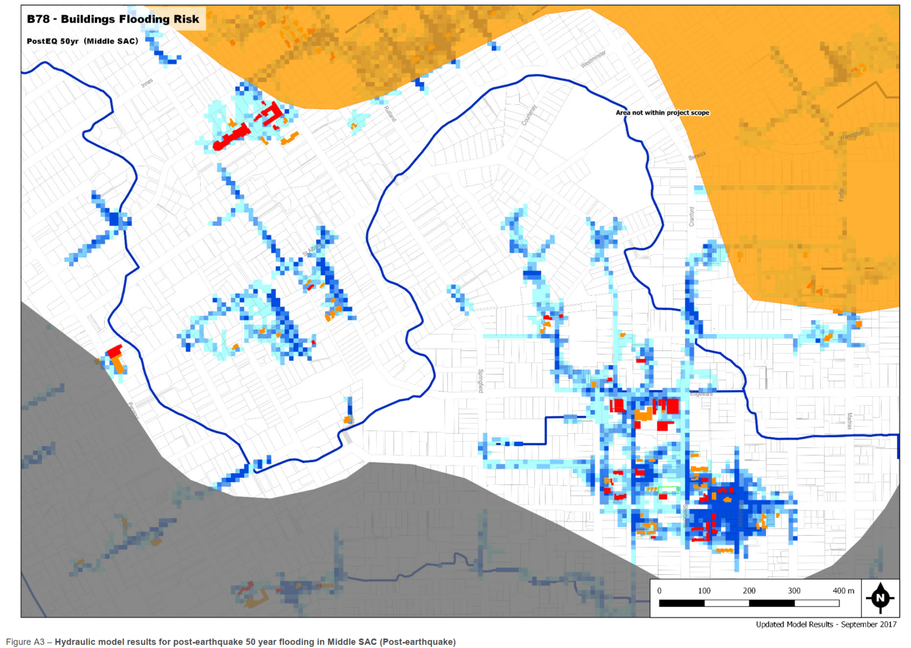
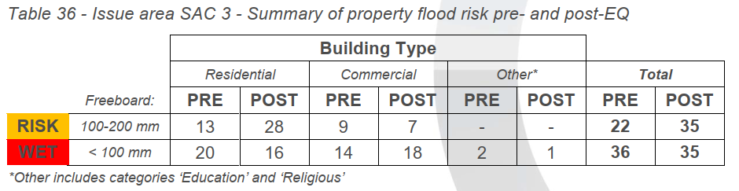
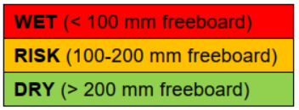
LDRP Investigation – Area Wide
Not all post EQ properties were at risk pre EQ
Not for Public Release

Slide 16
LTP
Some funding existed under the previous LTP
  FY 22 - 24 $6.3M for whole catchment
Funding was initially proposed by staff for the 2020-21 Annual Plan and the 2021-31 LTP
Current LTP Funding within IS ($23M) beyond 10 yrs (FY32+)
  Funding was moved out beyond the 10 years due to:
    Constrained financial envelope + COVID response
    Focus in 3W on drinking water supply and wastewater
    Application of Council prioritisation criteria

