Slide 1
Christchurch City Council
Draft Long Term Plan 2024-2034
Consultation open 18 March – 21 April 2024

Slide 2
A snapshot of what’s proposed . . .
$16.8 billion budget over 10 years, with $4.9 billion of that planned to be spent in the next three years.
$9.1 billion on day-to-day services the Council provides (e.g. waste collection, libraries, recreation and sports facilities).
$6.5 billion total capital investment over 10 years.
  - $226 million: road, footpath and cycleway renewals in the first three years of the LTP.
  - $480 million: renewing and upgrading our water networks in the first three years of the LTP.
$2.6 billion borrowing for the capital programme and repaying $1.2 billion of existing debt.
$41 million operational cost savings and additional revenue over the whole period of the LTP.

Slide 3
Proposed rates increase
 | Base rate | Te Kaha | Total
2024/25 | 11.08% | 2.17% | 13.24%
2025/26 | 5.98% | 1.78% | 7.76%
2026/27 | 3.99% | 0.69% | 4.67%
Tough economic environment.
Coincides with investment in Te Kaha and a reduction of $19 million in the CCHL dividend.
Limited control over a significant proportion of our proposed average rates increase – approx. 12% of the 13.24% is due to increased inflation, insurance and interest costs.

Slide 4

Proposed rates increase
Average residential rates increase: 12.4%
  - For an average house (value: $764,364) that’s an extra $416.23 a year, or $8 a week.
Average commercial property rates increase 14.2%
  - For an average property (value: $2,442,382) that’s an extra $2,316.74 a year or $44.55 a week.
Average remote rural property rates increase 15.4%
  - For an average remote rural property (value: 1,557,204) that’s an extra $435.34 a year or $8.37 a week.
Over the course of the 10 years of this LTP, the proposed rates increases average $4.72% a year, or 57.76% cumulatively.

Slide 5
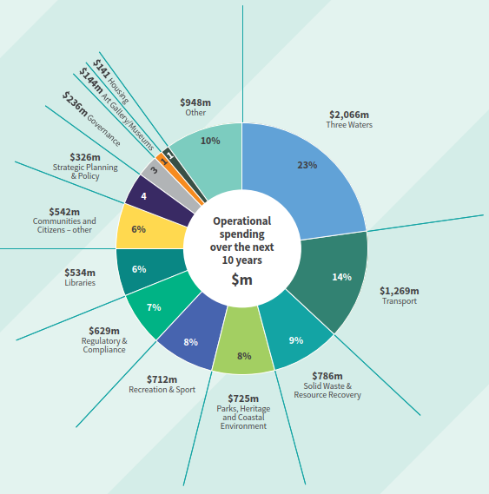
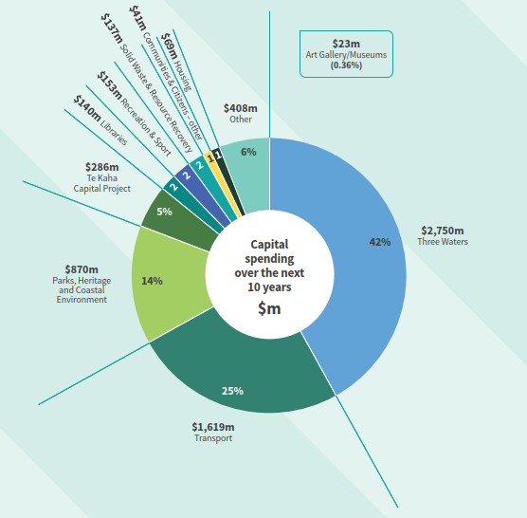
Operational spending over the next 10 years
Our proposed spending
Capital expenditure over the next 10 years
Our focus:
A deliverable capital programme.
Continuing to deliver the core services that our residents expect.
Investing appropriately in the future of our city.
Mitigating and adapting to climate change.

Slide 6
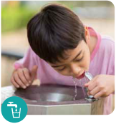
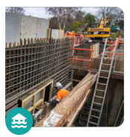
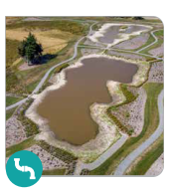
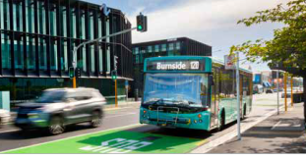
Delivering the services that matter to our residents
Transport
$1.6 billion over 10 years on infrastructure.
$1 billion on roads, footpaths and road infrastructure renewals.
$199 million on major cycleways.
$101 million on bus infrastructure – bus lanes shelters, intersection changes etc.
Drinking water supply
$873 million over 10 years.
Currently we have a target of 25% for leak rate – will reduce this to 20% by 2030 and 15% by 2034.
Stormwater and flood protection
$912 million on infrastructure over the next 10 years.
Wastewater
$964 million over 10 years on infrastructure.

Slide 7

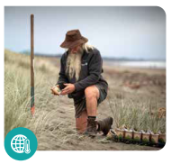
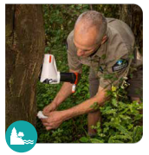

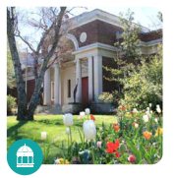

Delivering the services that matter to our residents
Waste and recycling
$64 million on recycling and transfer station improvements.
$22 million at Burwood and other landfills.
Parks and foreshore
$820 million over 10 years.
Libraries
$140 million over 10 years - $29 million of which is for rebuild of Ōmōkihi South Library.
Climate change
$318 million over 10 years on projects that have a direct impact on climate change mitigation.
$1 billion over 10 years on projects that help us adapt, and build resilience.
Heritage
$51 million over 10 years.
Recreation and sport
$153 million over 10 years.

Slide 8
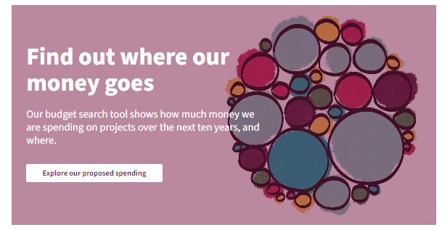
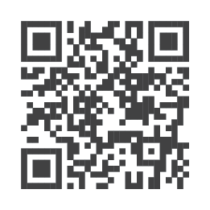
Bubbles budget tool
ccc.govt.nz/longtermplan
Enables you to explore our proposed budget by project, type of project, or by its community board area.
You can also view operational costs.

Slide 9
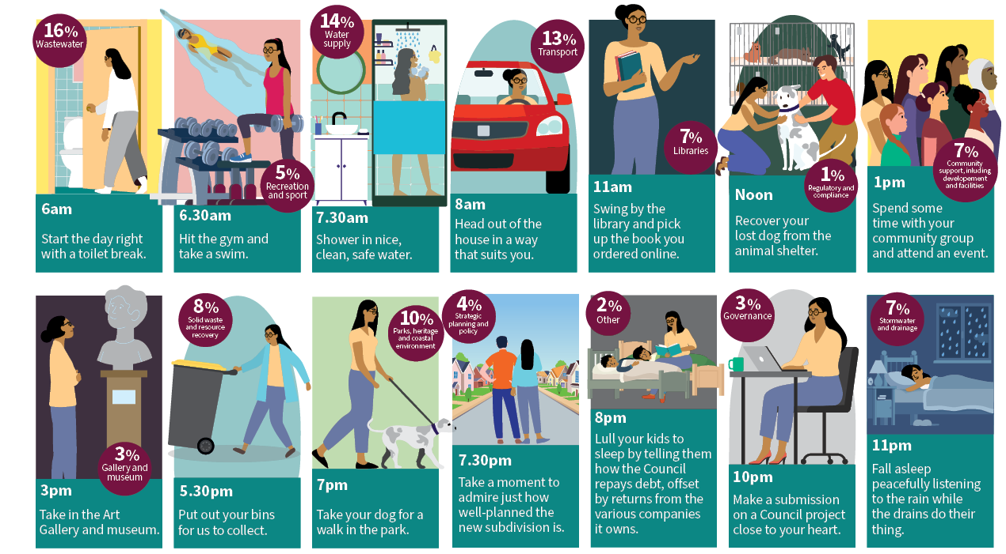
A day in the life of your rates . . .

Slide 10
Proposed changes to how we fund our asset renewals
We currently borrow to fund some of the cost of our annual asset renewal programme.
Since 2015 we’ve been transitioning to fully fund these renewals from rates – target is 100% by 2031.
Given cost pressures we’re currently facing, we’re proposing not to increase the level of rating for asset renewals in Year 1 and 2 of this LTP.
This approach has helped reduce the rates increase by 1.8% in Year 1 and by 1.2% in Year 2.
Longer term, there are consequences:
  - Our target to fund 100% of our asset renewals through rates pushed out to 2032.
  - While this means no change to amount of work done on renewals, there is change to how we fund the work. Now borrowing $93 million net more through to 2031 than initially planned (an extra $19 million in interest costs).
  - We don’t meet Balanced Budget benchmark for first three years of LTP. We return to having a balanced budget in Years 4-10 of the LTP.

Slide 11
Proposed changes to how we rate
City Vacant Differential rating – to include suburban centres (Linwood Village, New Brighton, Sydenham, commercial Lyttelton).
Rate visitor accommodation in a residential unit as a business (short-term un-hosted residential accommodation, eg Airbnb as a business activity).
Rates postponements – no longer automatically applied to ratepayers over 65 years.
Rates remissions for charities.
Incorporating Heritage Targeted Rate into general rate.
Incorporating Active Travel targeted rate into Uniform Annual General Charge.

Slide 12
Proposed changes to fees and charges and levels of service
Incorporated some changes to fees and charges to reflect increased cost of operating.
In some cases, fees cover the full cost of a service or are for a new service.
Proposal to introduce parking charges at Botanic Gardens and Hagley Park:
  - $4.60 for three hours.
  - Will generate $2 million a year. If we don’t proceed with this proposal, it will mean an extra 0.31% rates increase in Year 1.
Feedback from Residents Surveys: residents value the current range of services we provide. We are therefore, proposing only minor changes to levels of service.

Slide 13
Alternative opportunity
Potential to reduce or cut services to help reduce rates.
Where can we reduce services/save money without having a major impact on the community?
Tell us about the services that . . .
  - You value the most.
  - You could manage without.
  - Where there could be an opportunity for efficiencies.
We can make minor adjustments in response to feedback when the Council adopts this LTP, but major changes would require further consultation separate to this LTP.

Slide 14
Option: Bid funding for major and business events
Christchurch competes with other cities in New Zealand and around the world to attract major international sports, business and music events through event bid funding.
Preferred option:
  - Proposal to spend $4 million to continue to deliver our community events.
  - No additional event bid funding for first three years of this LTP.
  - No change to proposed rates increase.
  - Risk: Christchurch may be less likely to attract as many major and business events.
Option to provide additional event bid funding:
  - Will enable us to attract more major and business events.
  - Will mean an additional rates increases for next three years. e.g. 2024/23 – 0.42% rates increase.

Slide 15
Option: Accelerate adaptation efforts
Our district faces diverse climate hazards, from rising sea levels to more frequent extreme weather events.
Preferred option:
  - Maintain the Coastal Adaptation Planning Programme at $1.8 million per year, which will increase to another $1.8 million in 2027/28 as adaptation planning work ramps up across the district.
  - No change to proposed rates increase.
  - Risk: we will be slower to complete community adaptation plans.
Option to accelerate adaptation planning:
  - We could bring forward the additional $1.8 million to 2024/25.
  - This will accelerate the Coastal Adaptation planning programme and boost overall community preparedness and resilience.
  - Will mean a rates increase of 0.29% from 2024/25.

Slide 16
Option: Climate Resilience Fund
Climate change is creating new levels of complexity for our infrastructure. To address this, we could start setting aside funds now to manage necessary changes to the capital programme in the future.
Preferred option:
  - Climate adaptation related capital expenditure is included in our capital programme. No dedicated fund.
  - No change to proposed rates increase.
  - Risk: future generations may need to contribute more to address climate resilience.
Option to create a Climate Resilience Fund:
  - Fund ringfenced to support actions originating from adaptation plans.
  - We could amass as much as $127 million, assuming we start the fund in Year 2 of the LTP.
  - Will have a 0.25% impact on rates for each year it is implemented. For the life of this LTP it will be a 2.25% rates increase.

Slide 17
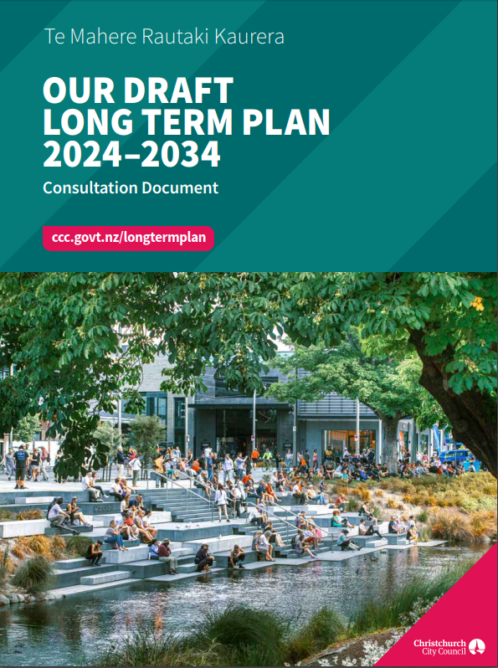

How to have your say
Consultation open from Monday 18 March to 11.59pm Sunday 21 April 2024
Consultation Document, Draft LTP, submission forms available at:
  - ccc.govt.nz/longtermplan
  - Council libraries and service centres.
Hearings will be held from early May.

