Slide 2

THE WAY FORWARD: Part 2
Mental Health & Addictions Services

Slide 3
RECAP
10 YEAR PLAN:
We want to create a sector leading model of excellence in BOP Mental Health and Addictions Services over the next 10 years
HERE AND NOW:
The application of Creating our Culture within MH&AS

Slide 4
A Definition of success . . . .
Being the best possible version of ourselves
and
Being absolutely amazing together

Slide 5
RECAP: KEY MESSAGES
Remember how you got here and how amazing you are
Let’s share our knowledge, skills and expertise to create something amazing
We’re making an immovable commitment to improve safety, culture and wellbeing
    A time of listening and understanding
    We’ll need your help

Slide 6
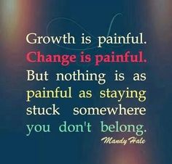
BREAKING THROUGH

Slide 7
WHAT WE’VE BEEN DOING
Exploration of the work culture within MH&AS
Connecting people and teams
Psychiatrist resources
Complex HR issues
Planning for National Review Panel Visit
Gearing up resources
Listening and learning

Slide 8

Mental Health and Addictions Services
A huge thanks!
We want to acknowledge the large number of staff who have constructively contributed to the review
We found staff were keen to participate, open, respectful of the process, and thoughtful in the contribution
The level of expertise, commitment and desire to keep improving – is high and consistent across all staff!
Most of what we found added clarity, context and greater understanding of themes of concern that some of you have been expressing over time

Slide 9
Mental Health and Addictions Services
Where we started:
The workload is immense and sometimes it feels like we’re drowning
Some of our accommodation is awful
We feel unsafe at times and nobody seems interested
We have a low trust, punitive workplace culture
We need a safe place to have a voice and be heard
We want to help make things better
Vision:
We want to create a sector leading model of excellence for MH&AS across the Bay over the next 10 years

Slide 10
Mental Health and Addictions Services
What we did:
Met with nearly 150 staff over 12 weeks
In the order of 300 hours of interview time
Interviews were voluntary except for the cluster leaders Covered all services and disciplines at Tauranga and Whakatane

Slide 11
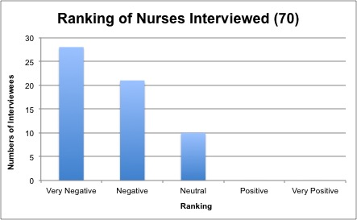
Mental Health and Addictions Services

Slide 12
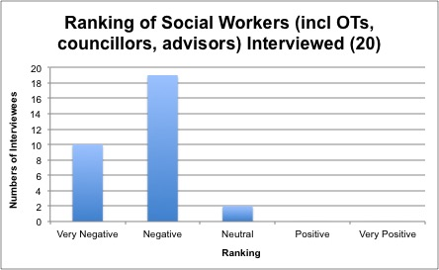
Mental Health and Addictions Services
Ranking of Allied Health (including Social Workers, OTs, Counsellors, Advisors)

Slide 13
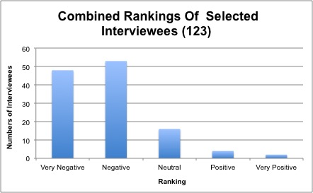
Mental Health and Addictions Services

Slide 14
Mental Health and Addictions Services
What we found:
A number of consistent themes:
  A significant amount of stress and distress
  A need to rebuild trust and confidence in the Cluster Leadership team
  A strong desire to change the culture . . .large shift towards the CARE values
  More distributed leadership – greater involvement and more listening and genuine conversation/consultation
  A greater level of teamwork/respect across disciplines
  Clearer, more consistent long term service development plan
  A need to raise the wellbeing, health and safety for the benefit of all staff and clients

Slide 15
LEARNINGS
MHSOP/Older People: Demand pressure
ADULT INPATIENT: Staff safety
CAMHS & Voyagers: Demand & system pressures
COMMUNITY, BOPAS: Models of Care
ALL – dedication, commitment – thank you.

Slide 16

Time to move forward

Slide 17
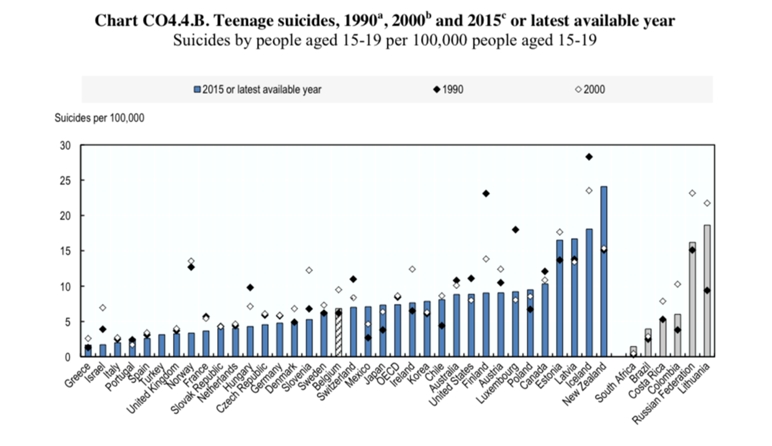


Slide 18
1. Organising ourselves
Interim leadership arrangements
DAMHS
DSA
Nursing & Operations
CD/ Medical Leader
Allied Health Leader
Business Lead
Quality & Safety Lead
Service Co-ordinator
Cultural Co-ordinator
Transformation Lead
H&S
Maori Health
SIU NETWORK

Slide 19
2. WORK PLAN FOCUS AREAS
A safe place to work
CARE embedded
Excellence in communications, engagement and team work
Physical and psychological safety, safe to raise concerns, team level interpretation of CARE, creating high trust environments
Philosophy and Models of Care
Capacity & Demand
Approach to service delivery, staffing levels, resourcing, Robust model for EBOP, HCN/Forensics, ACE development
Well organised
Smart business processes
Clear roles & resps, robust structure, HODs, IT/documentation, minimising duplication and wasted effort
Workforce development
Strong partnerships
Recruitment strategy, training. Internal and external partnerships incl. Unions, NGOs, Paediatrics, Medical Health

Slide 20
3. NEXT STEPS
EOI for Interim CD
OnePlace discussion forum for MH&AS
Interim Business and Transformation lead roles progression
Workshop (date tbc) to define concept desired future state, co-ordinate input, sequence work priorities
Collate information for the National Review Panel – use for internal reference too
Campus Plan – Mental Health focus workshop in July.

Slide 21


Slide 22

Look beyond the now . . . to what could be and let’s go after it with everything we’ve got

